Slide 1

RAJIV GANDHI UNIVERSITY rono hills, doimukh (arunachal pradesh)
PROJECT PRESENTATION ON:- TOURISM MANAGEMENT SYSTEM
PROJECT GUIDE:- Bhaskar Jyoti
Submitted by
Ajay Prajapati(15BCA002)
Taba nunu(15BCA011)

Slide 2
CONTENTS
1.Introduction
2.Objective
3. Modules Of Tourism Management System
4.ER-diagram
5.UML Diagram
6.Activity Diagram
7.Detail Design
8.Input Design
9.Future Enhancement

Slide 3
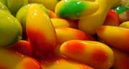
Introduction
The tourism and travels management system is a web based application.
The main purpose is to provide convenient way for a customer to book hotels, etc.
In this project, we will make an easier task of searching place and for booking train, flights, bus, etc.
it will help to replace the old manual.

Slide 4
Objective
This application is develop to provide best tourist services to the customers.
We have developed Tourism Management System to provide a view package platform where a tourist can find their tour places according to their choices.
This system also helps to promote responsible and interesting tourism so that people can enjoy their holidays at their favourable places.
This system also helps to develop tourism with different cultures so that they enrich the tourism experience and build pride.
We develop this system to create and promote forms of tourism that provide healthy interaction opportunities for tourists and locals and increase better understanding of different cultures, customs, lifestyles, traditional knowledge and believe. This system also provides a better way to connect with various events.

Slide 5
Modules Of Travels And Tour Management System
5.User Registration
a. Sign Up/Registration(User)
6. Enquiry Module
a. User Enquiry Form
7. About Module
a. About Web Application
1. Admin Module
a. Manage User Information
b. Update Information
c. Manage Bookings
d. Manage Payment
2. User Module
a. Login/Register
b. User Profile
c. Make Bookings
d. Make Payment
e. Feedback
3. Gallery Module
a. Pictures
b. Videos
4. Package Module
a. Package Information

Slide 6
UML Diagram
Login
Manage User
Manage Package
Manage Booking’s
Manage Payment
Admin
View Feedback
View Enquiry

Slide 7
UML Diagram
View Package
Make Bookings
Cancel Booking
Feedback
User
Registration
Make Payment

Slide 8
Activity Diagram of web application
Home Activity
Home
Gallery
Package
User Registration
User Login
Admin Login
Enquiry
About
Home details
Images / videos
Package details
No
Valid
No
Enquiry From
About web application
Valid
Yes
Manage User
Manage Package
View Package
Booking Package
Manage Package categories
Cancel Booking
Manage package sub-categories
Update Booking
Cancel Booking
Manage Bookings
Figure: Activity Diagram of web application
Feedback
Manage Feedback
View Enquiry

Slide 9
Detail Design
Data Flow Diagram
Home Screen Module: Home screen is the second page that will be displayed when the user click on registration button of welcome page that is the first page. Home screen displays buttons for different modules like Gallery, Package, User Registration, User login, Admin Login, Enquiry, and About.
Home
Gallery
Packages
User Select
Display navigation buttons on the top of screen
User Registration
Web Application
User Registration
User click
User Display
User Login
Admin Login
About
Enquiry
Figure: DFD for Home Screen

Slide 10
Address
username
password
Password
username
password
Confirm Password
Mobile no.
1
Manages
Admin
M
User
Type of user
Email id
1
1
1
1
1
1
1
Manages
Book
Email id
M
Booking
Package id
price
Date
Package name
Vehicle type
User name
No. members
Hotel type
Full address
Manages
M
Payment
Give
M
Payment Mode
Ac/Card no.
Exp. Date
holder name
M
Package
View
M
Package id
Price
Package Name
Sub-category
View
Price
category
Give
M
Feedback
M
ER-Diagram
Email id
User name
Feedback

Slide 11
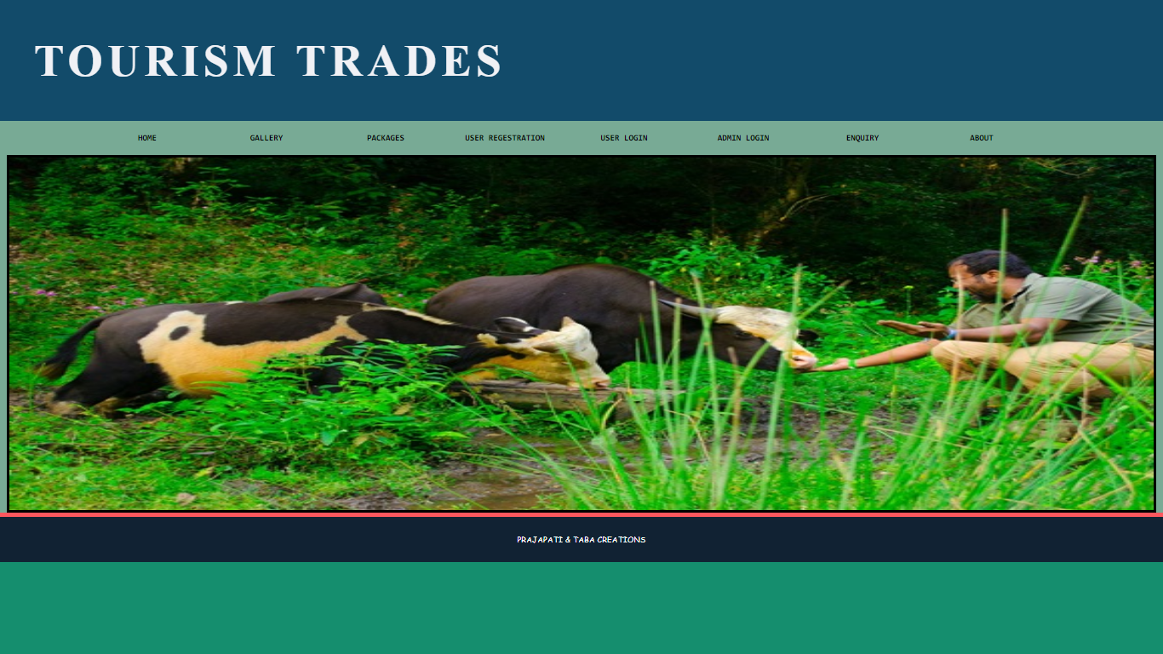
Input Design
HOME PAGE
Description: Home page of Tourism Management system.

Slide 12
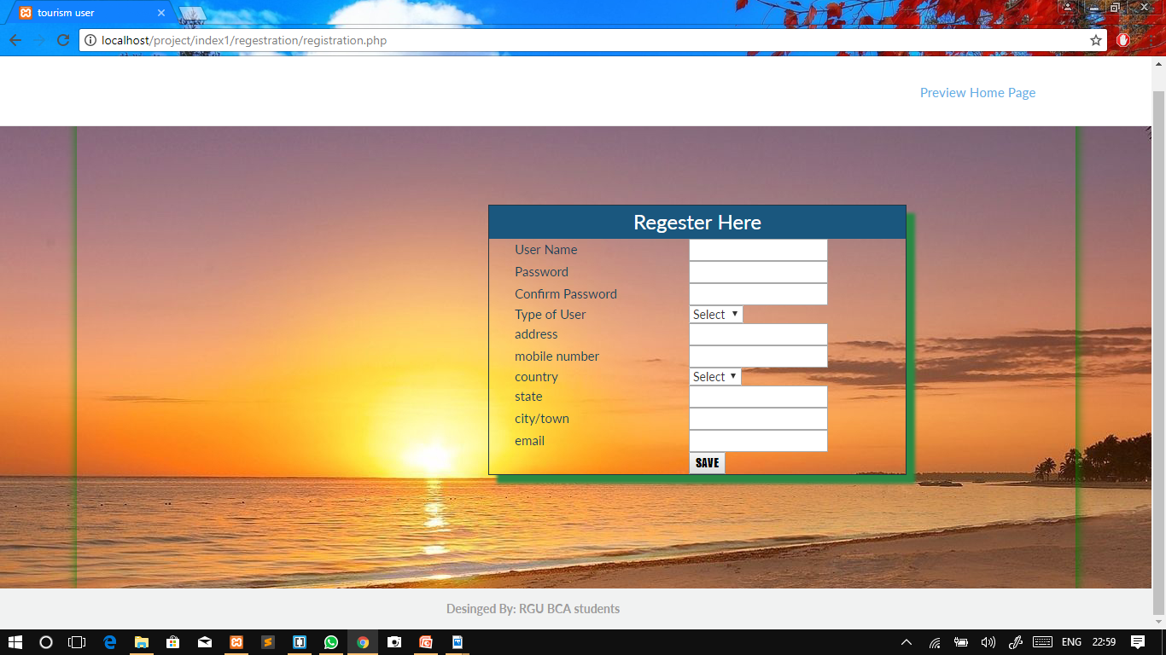
Input Design
REGISTRATION
Description: Registration page of Tourism Management system.

Slide 13
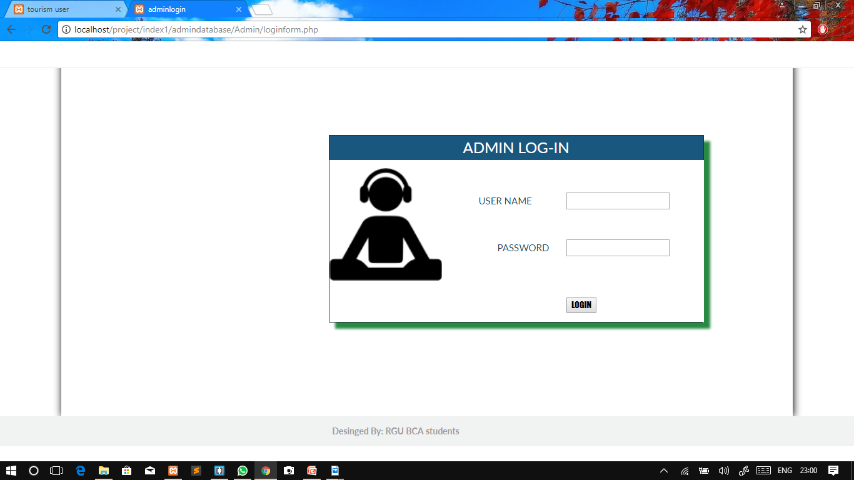
Input Design
ADMIN LOGIN
Description: Admin Login Page of Tourism Management system.

Slide 14
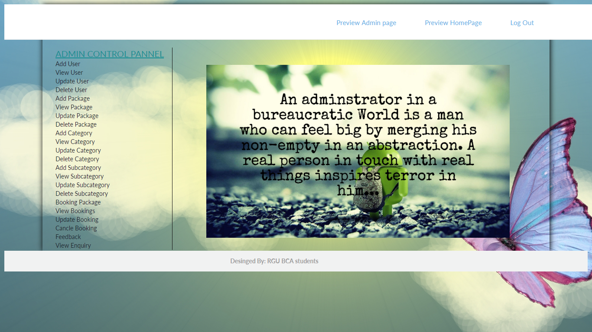
Input Design
ADMIN HOME
Description: Admin Home Page of Tourism Management system.

Slide 15
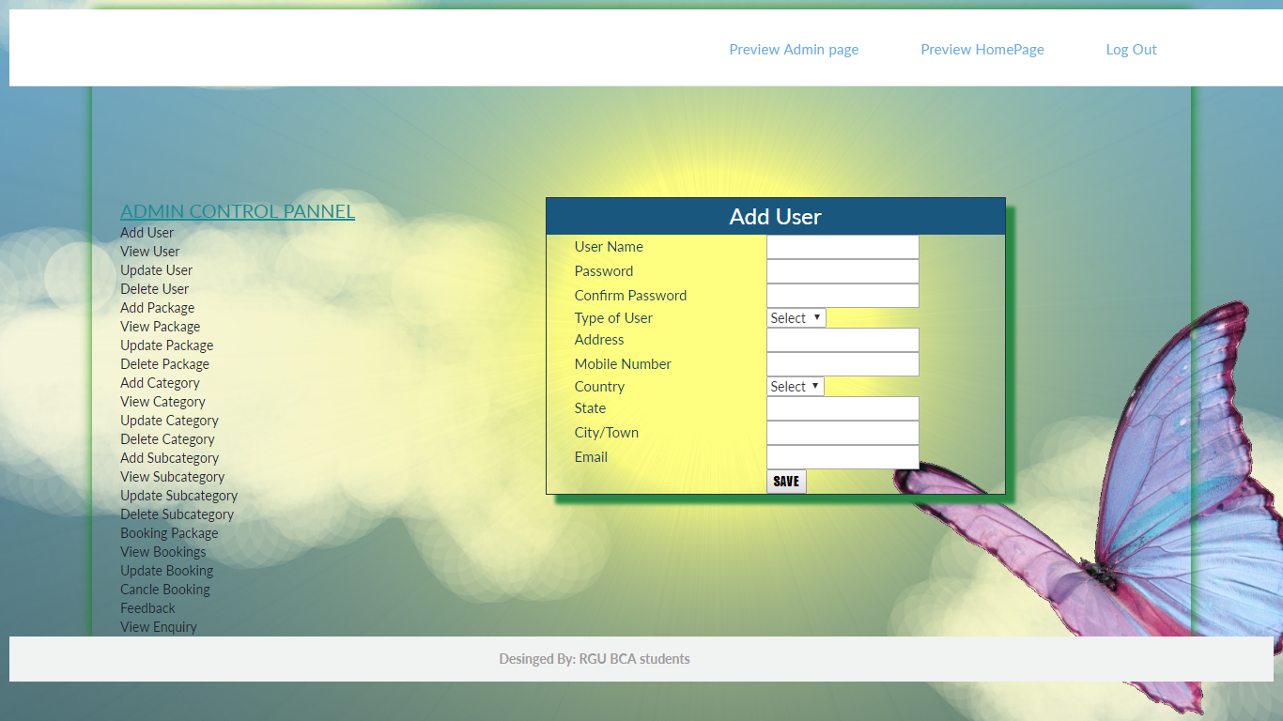
Input Design
ADDUSER
Description: Adduser Page of Tourism Management system.

Slide 16
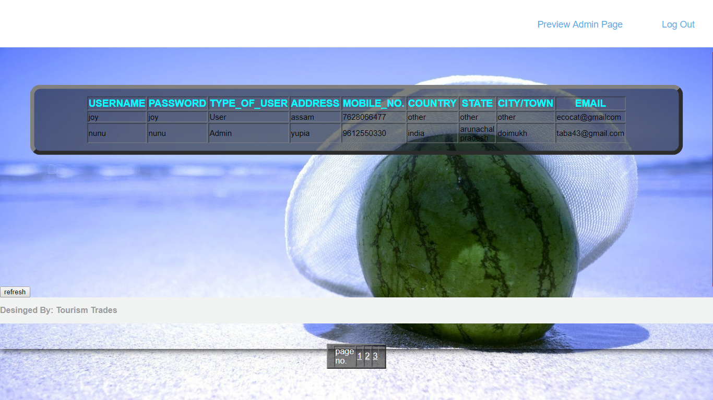
Input Design
VIEW USER
Description: View User Page of Tourism Management system.

Slide 17
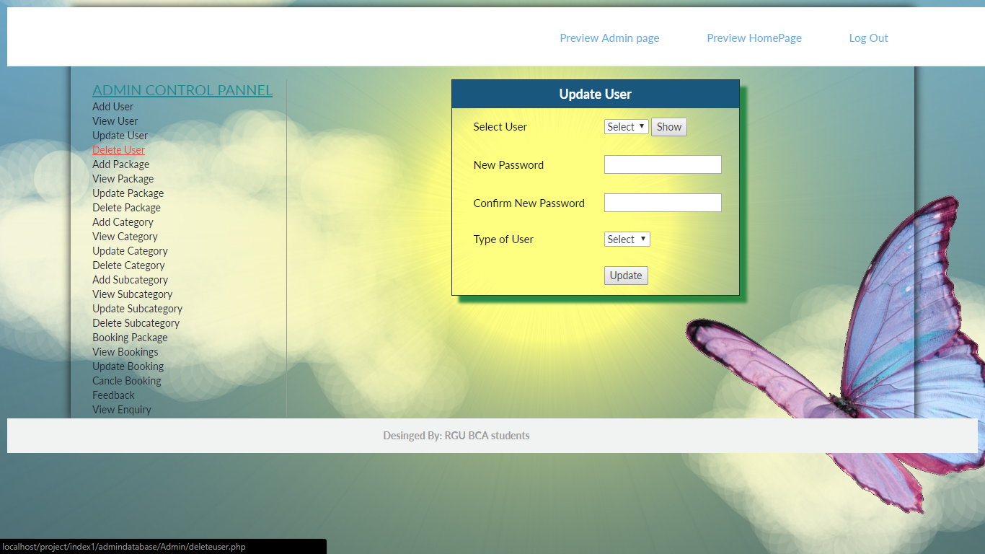
Input Design
UPDATE USER
Description: Update UserPage of Tourism Management system.

Slide 18
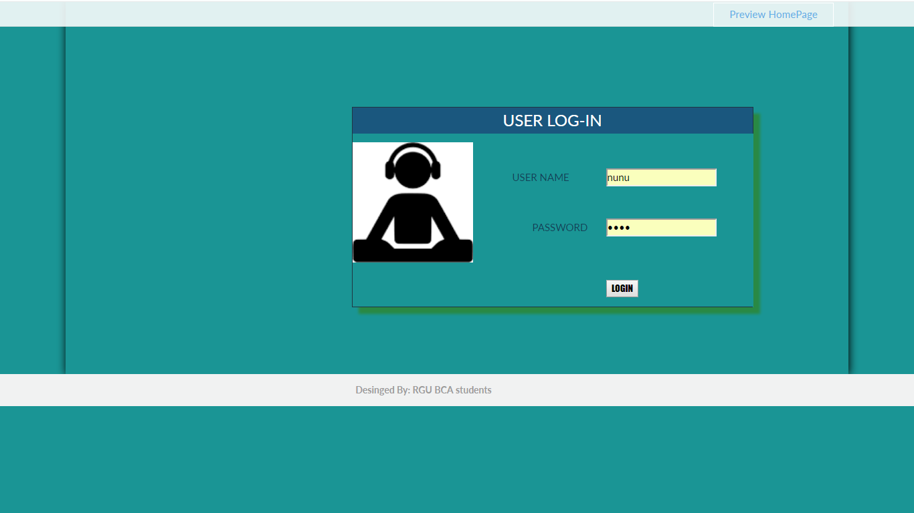
Input Design
USER LOGIN
Description: User Login Page of Tourism Management system.

Slide 19
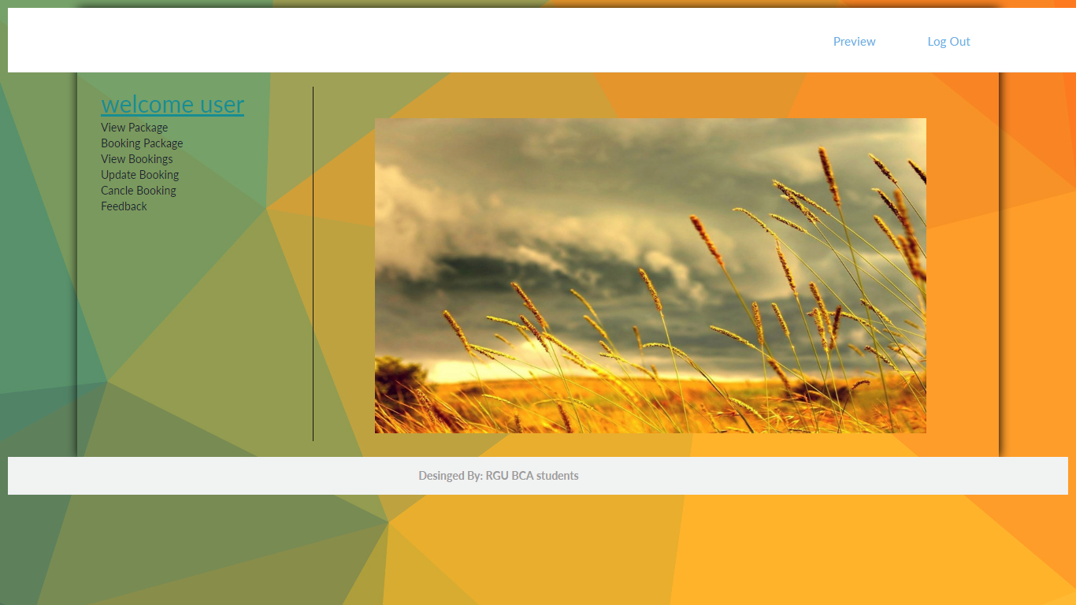
Input Design
USER Dashboard
Description: Delete UserPage of Tourism Management system.

Slide 20
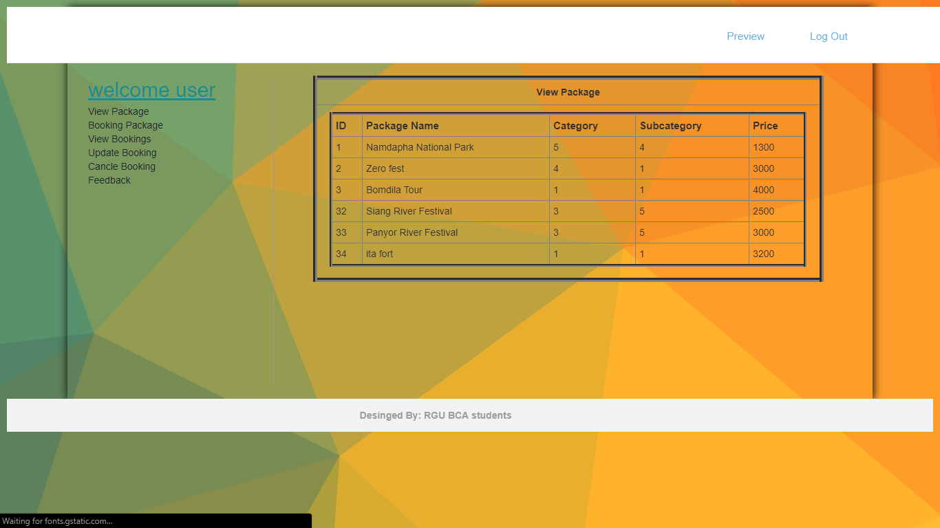
Input Design
view Package
Description: view Package Page of Tourism Management system.

Slide 21
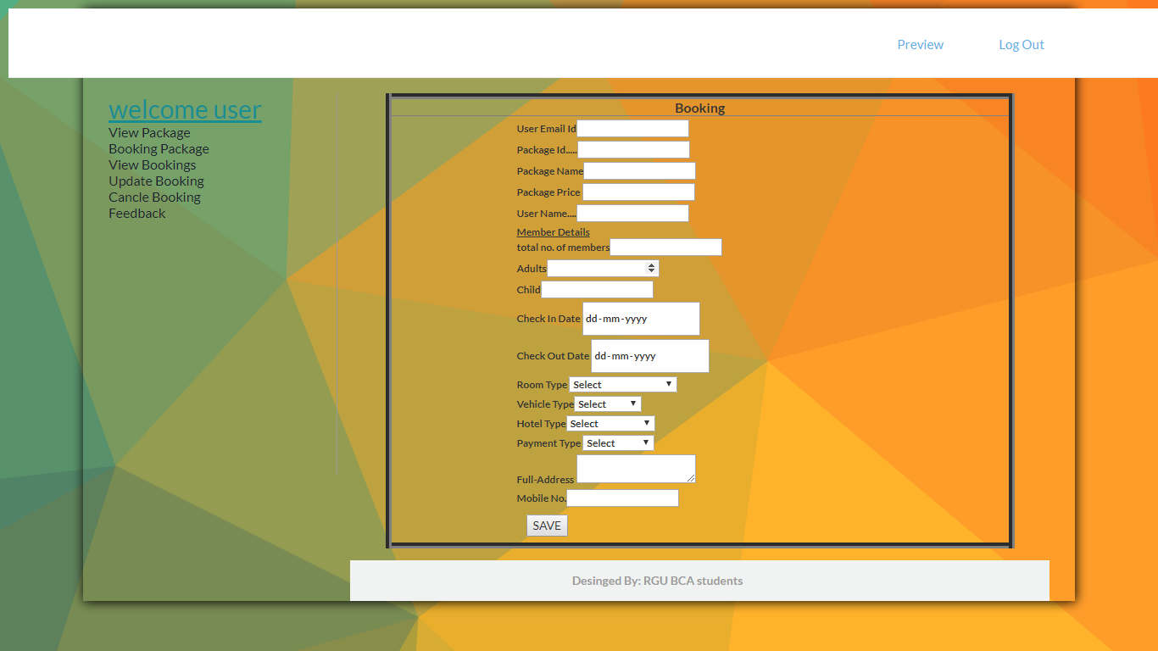
Input Design
Booking Form
Description: Booking Page of Tourism Management system.

Slide 22
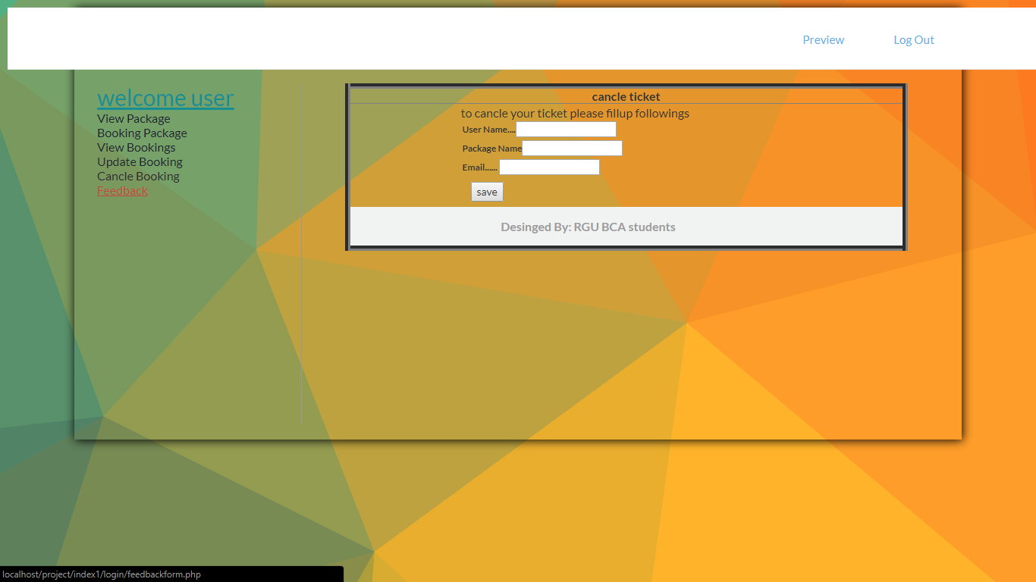
Input Design
Cancel Booking
Description: Cancel Booking Page of Tourism Management system.

Slide 23
FUTURE ENHANCEMENT
1.In future we will give facility of online donation.
2.More modules will be included in the system like Routs, Gallery, About etc.
3.We will include more functionality as per user requirement.
4.Not a single website is ever consider as complete forever firstly because there is always something new requirement also are growing day by day.
5.We want to improved our home page, as it is the main thing which attracts all users

Slide 24
THANK YOU...

